Slide 1
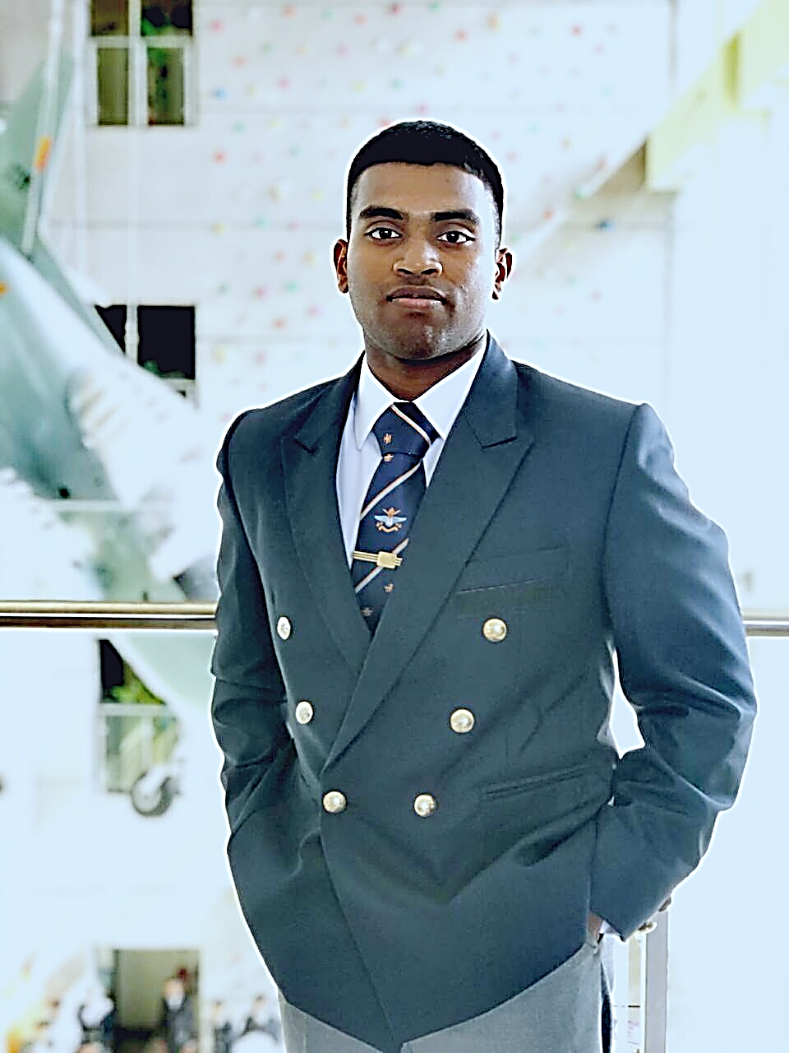
About Me
Personal Profile
Name : Yasith Fonseka
Age : 24 Years
Hometown : Kegalle
Nationality : Sri Lankan
Marital Status : Unmarried
Language : Sinhala / English
Education
Dharmaraja College/Kandy : GCE O/L and GCE A/L
Sir Jhon Kotelawala Defence University: BSc (Hons) in Information Technology
Achievements
KDU Colors holder
Working Experience
Associate Engineer Systems - CodeGen International (Pvt) Ltd
Hobbies and Sports
Programming (Learn about different languages and built things like games, softwares
Martial Art
Personal Traits
Communication Skill
Leadership Skill

Slide 2

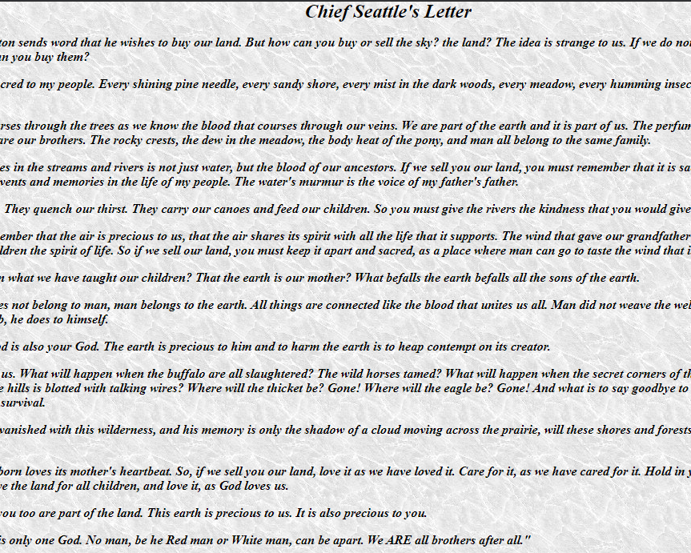


Chief Seattle
Chief Seattle (more correctly known as Seathl) was a Suquamish chief who lived on the islands of the Puget Sound. As a young worrier, Chief Seattle was known for his courage, daring and leadership. He gained control of six of the local tribes and continued the friendly relations with the local whites that had been established by his father. Its not because he is afraid, but he knows that local whites are strong than them and he did not want to get more trouble for his people.
He was very peaceful guy. Not much educated but he educated more than everyone.
He was good leader, and he is more famous because his letter.

Slide 3

London Stock Exchange Group
London Stock Exchange Group PLC is a British-based stock exchange and financial information company.
It’s headquartered in London, England
It owns the London Stock Exchange, as well as Borsa Italiana, Refinitiv, LSEG Technology, FTSE Russell, and majority stakes in LCH and MTS.
LSEG is a diversified international markets infrastructure business and have earned clients’ trust for over 300 years. The Group can trace its history back to 1698.
LSEG as global leaders in financial indexing, benchmarking and analytic services, they offer unrivalled access to international capital markets. And their high-performance technology solutions enable companies worldwide to access funds for growth and development.
With their Data & Analytics, Capital Markets and Post Trade divisions, They provide a comprehensive, integrated suite of trusted financial market infrastructure services that help customers pursue and achieve their ambitions.
The Group operates a broad range of international equity, exchange-traded fund, bond and derivatives markets. This includes London Stock Exchange, Borsa Italiana, MTS (a European fixed income market) and Turquoise (a pan-European equities multilateral trading facility). Through its different platforms, LSEG offers market participants unrivalled access to Europe's capital markets. The Group also plays a vital economic and social role, enabling companies, including SMEs, to access funds for growth and development.

Slide 4
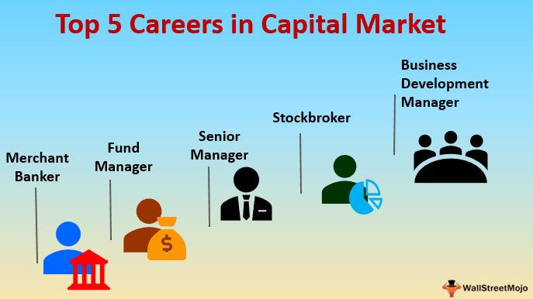
Capital Market
A capital market is an organized market in which both individuals and business entities buy and sell debt and equity securities. It is designed to be an efficient way to enter purchase and sale transactions. This market is a key source of funds for an entity whose securities are permitted by a regulatory authority to be traded, since it can readily sell its debt obligations and equity to investors. Governments also use capital markets to raise funds, typically through the issuance of long-term bonds. Governments do not issue shares, and so cannot issue equity securities.
A good market is essential prerequisite for industrial and commercial development of country.
This can be defined as an organized mechanism for effective and efficient transfer of money capital or financial resources from the investing parties to the entrepreneurs engaged in industry or commerce.
Capital market ensure best possible coordination and balance between the flow of savings on the one hand and the flow of investment leading to capital formation on the other. Also direct the flow of savings into most profitable channels and thereby ensures optimum utilization of financial resources.
Largest stock markets in the world , NASDAQ, London Stock Exchange, and Tokyo Stock Exchange

Slide 5
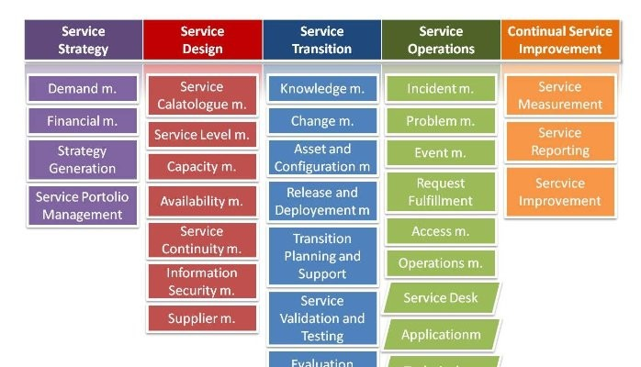
ITIL
Information Technology Infrastructure Library is a set of detailed practices for IT service management that focuses on aligning IT services with the needs of business.
ITIL describes processes, procedures, tasks, and checklists which are neither organization-specific nor technology-specific, but can be applied by an organization toward strategy, delivering value, and maintaining a minimum level of competency.
ITIL allows the organization to establish a baseline from which it can plan, implement, and measure.
Also, it is used to demonstrate compliance and to measure improvement
Important of this ITIL is it equips a service provider with a clear capability model, aligning them to the business strategy and customer needs. The ITIL best practice framework provides a common language and tools that power collaboration within IT teams, to deliver value across a business.

Slide 6

Importance of an Application Support Engineer for a Production System.
Ensure the 24 x 7 x 365 availability of the system.
installation and maintenance of software applications in order to streamline business operations
Proactive monitoring, escalation and resolving issues upon agreed service levels.
optimizing software application performance, installing updates, and performing debugging procedures
For setup and configure environments as needed
Environment management and maintenance.
Technical support to external clients when required.
Reporting and documentation.
Change and Release management.

Slide 7
Why Do I Want To Work As An Application Support Engineer
Application Support engineer is not just a job, it is lifeline to our customers. So, we are at the forefront of the company. That is the cool part of this job roll. We can make our customers lives less stressful when they need us.
Through this we can improve our different interpersonal skills such as communication skills, Leadership skills etc.
This roll allow us to provide different IT support levels which depend on the situation but basically provide level 0, 1 and 2. Which will huge opportunity to increase our experiences in our carrier.
I consider this opportunity as a big chance of my life to learn new things more and move forward in my carrier.

Slide 8

Big Thanks For The Opportunity…!

